Slide 1
A project on Resume Classification
Business objective-
The document classification solution should significantly reduce the manual human effort in the HRM. It should achieve a higher level of
accuracy and automation with minimal human intervention
AIM-
To build the best model which gives the maximum performance, and need to deploy the model with either RShiny or Flask/ stream lit

Slide 2
Mentor name- Pallavi B
Mr. Rohit Dilip Shivramwar
Mr. GANESH SURESH NAIK
Miss. Vidhya Laxman Pawar
Ms. Rutika Laxman Patil
Ms. Pooja Madhav Kharatmol
Mr. Harib Parol
Mr. Ashish Suresh Shelke

Slide 3
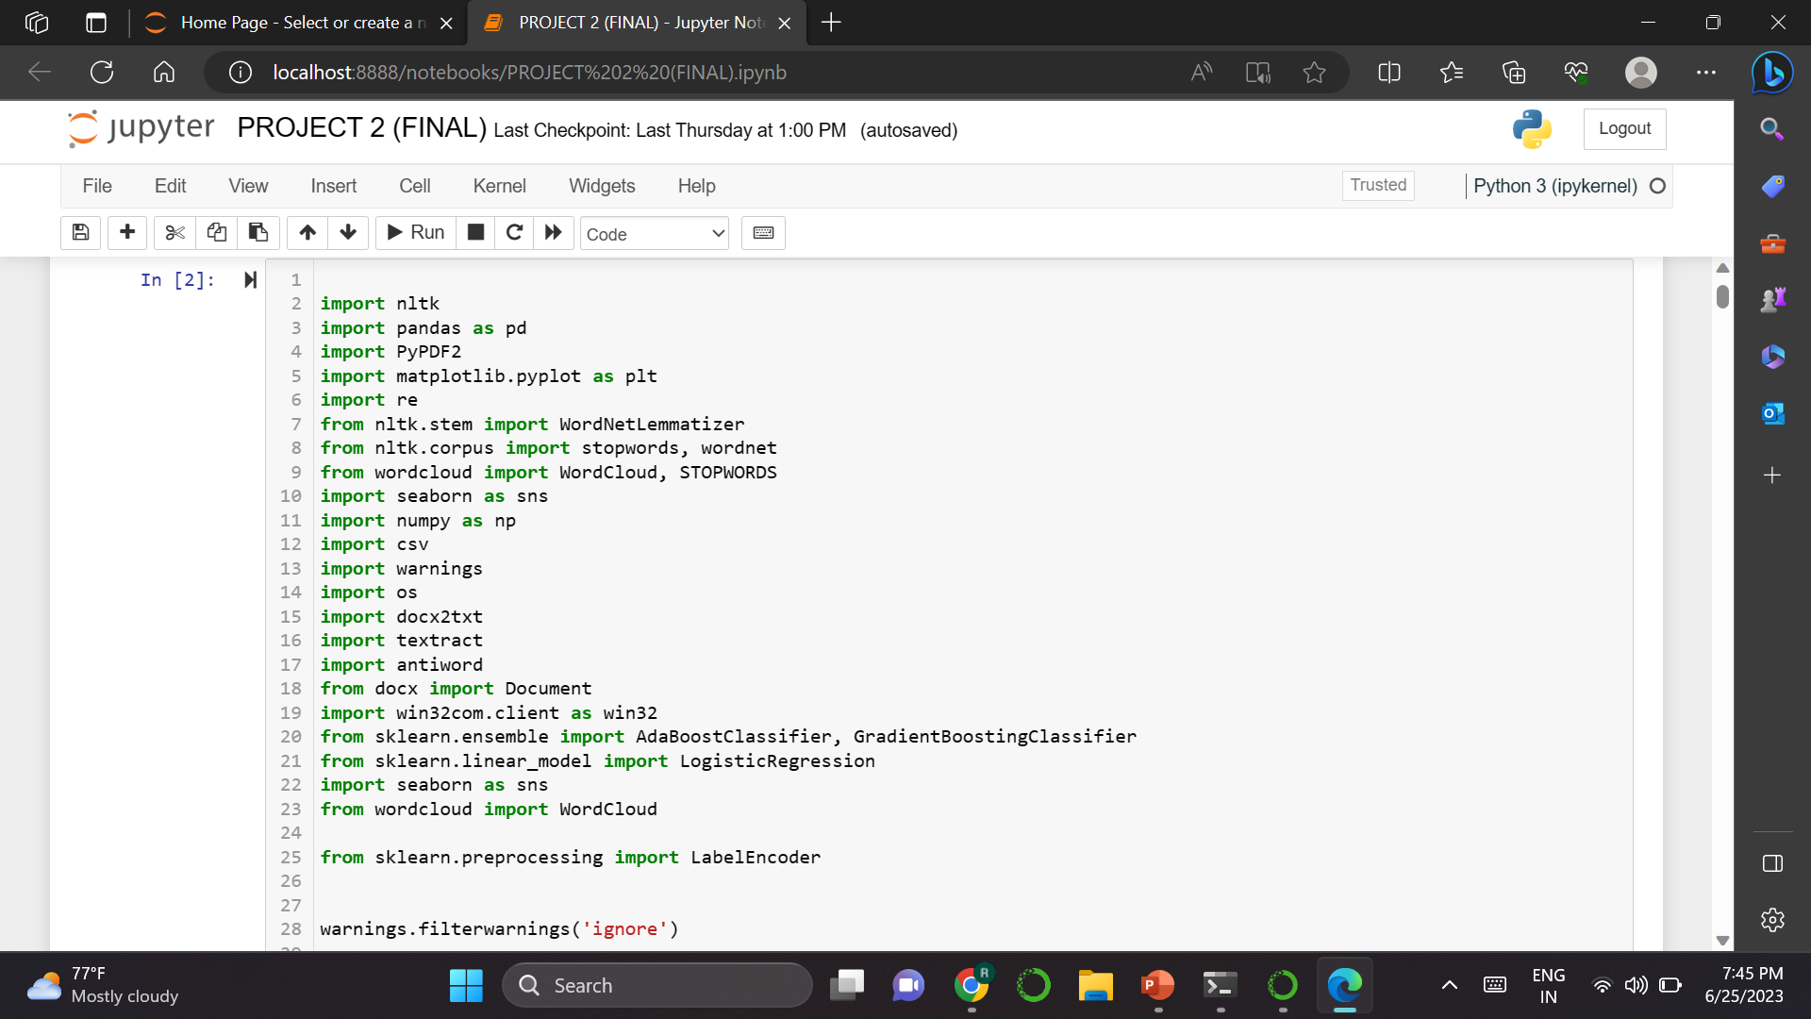
IMPORTED REQUIRED LIBRARIES

Slide 4
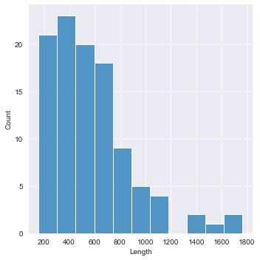
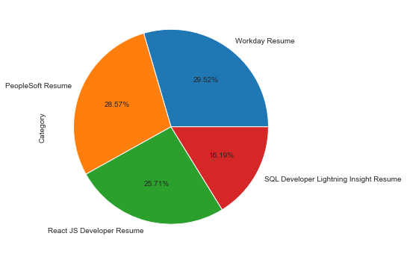
Graphical representation of the distribution of the data category wise

Slide 5
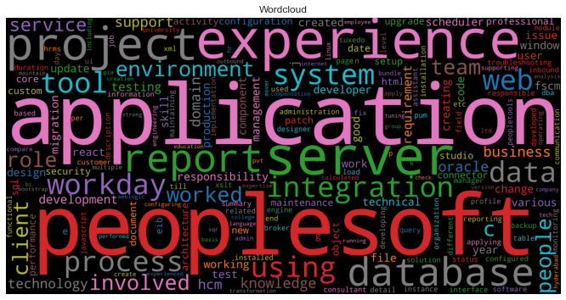
Frequency of the words used In entire dataset.

Slide 6
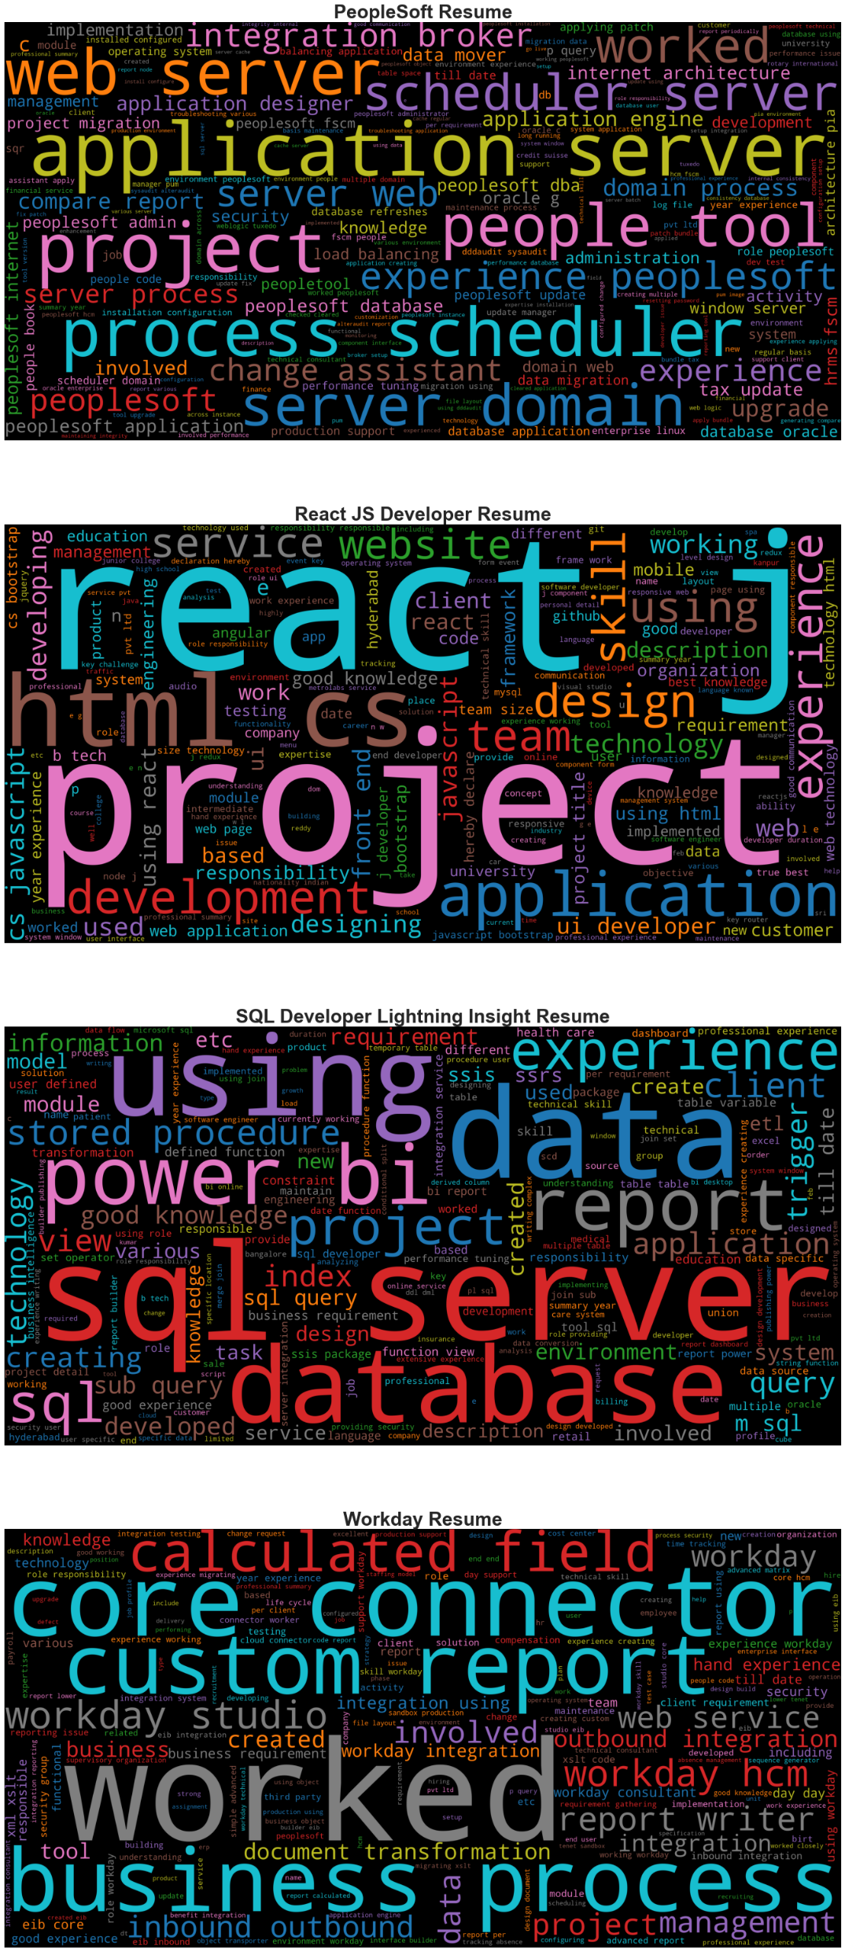
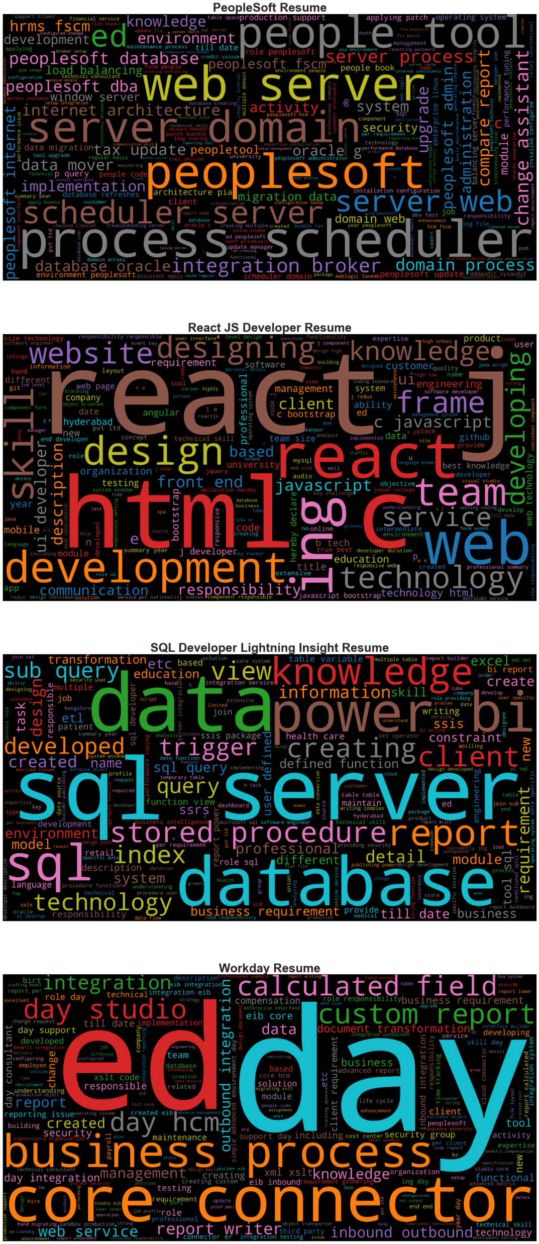

Slide 7
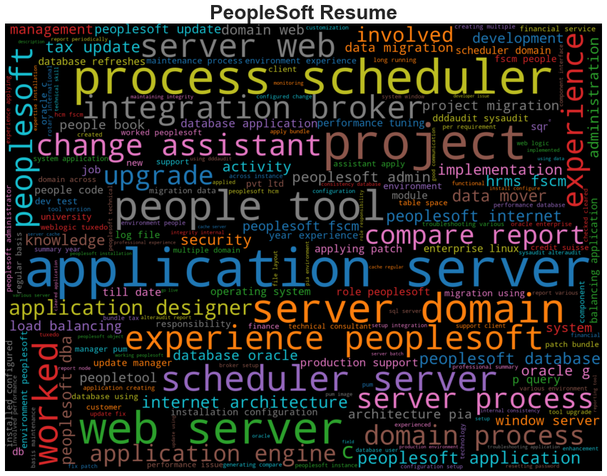
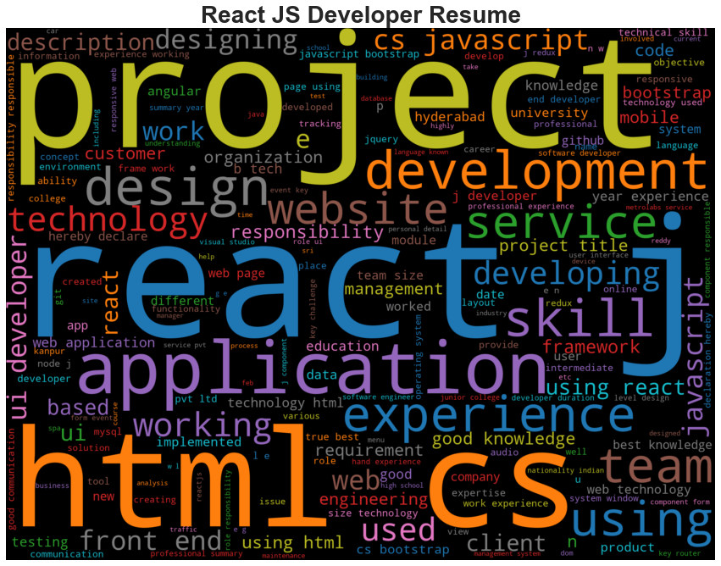
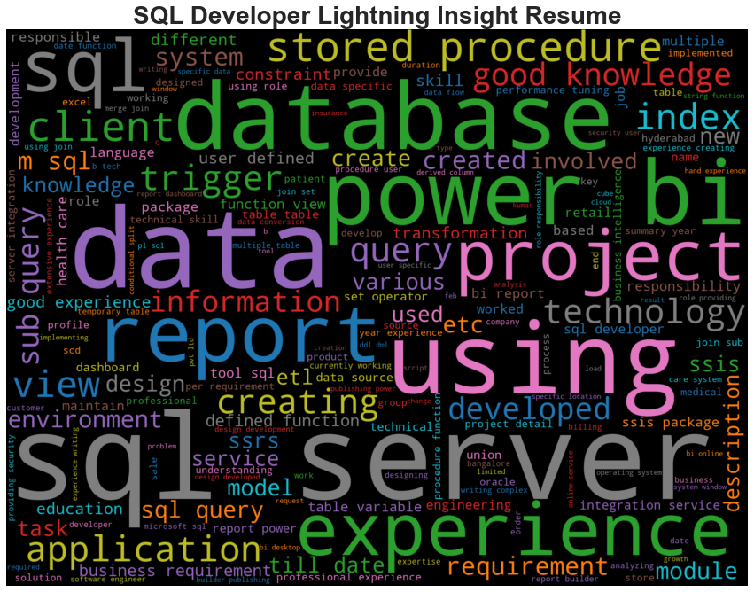
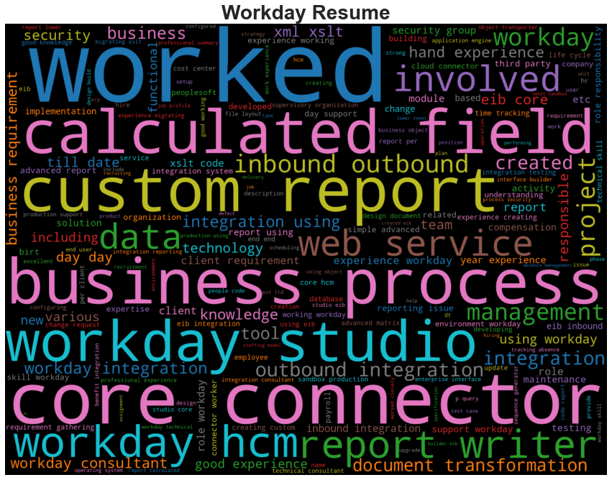

Slide 8
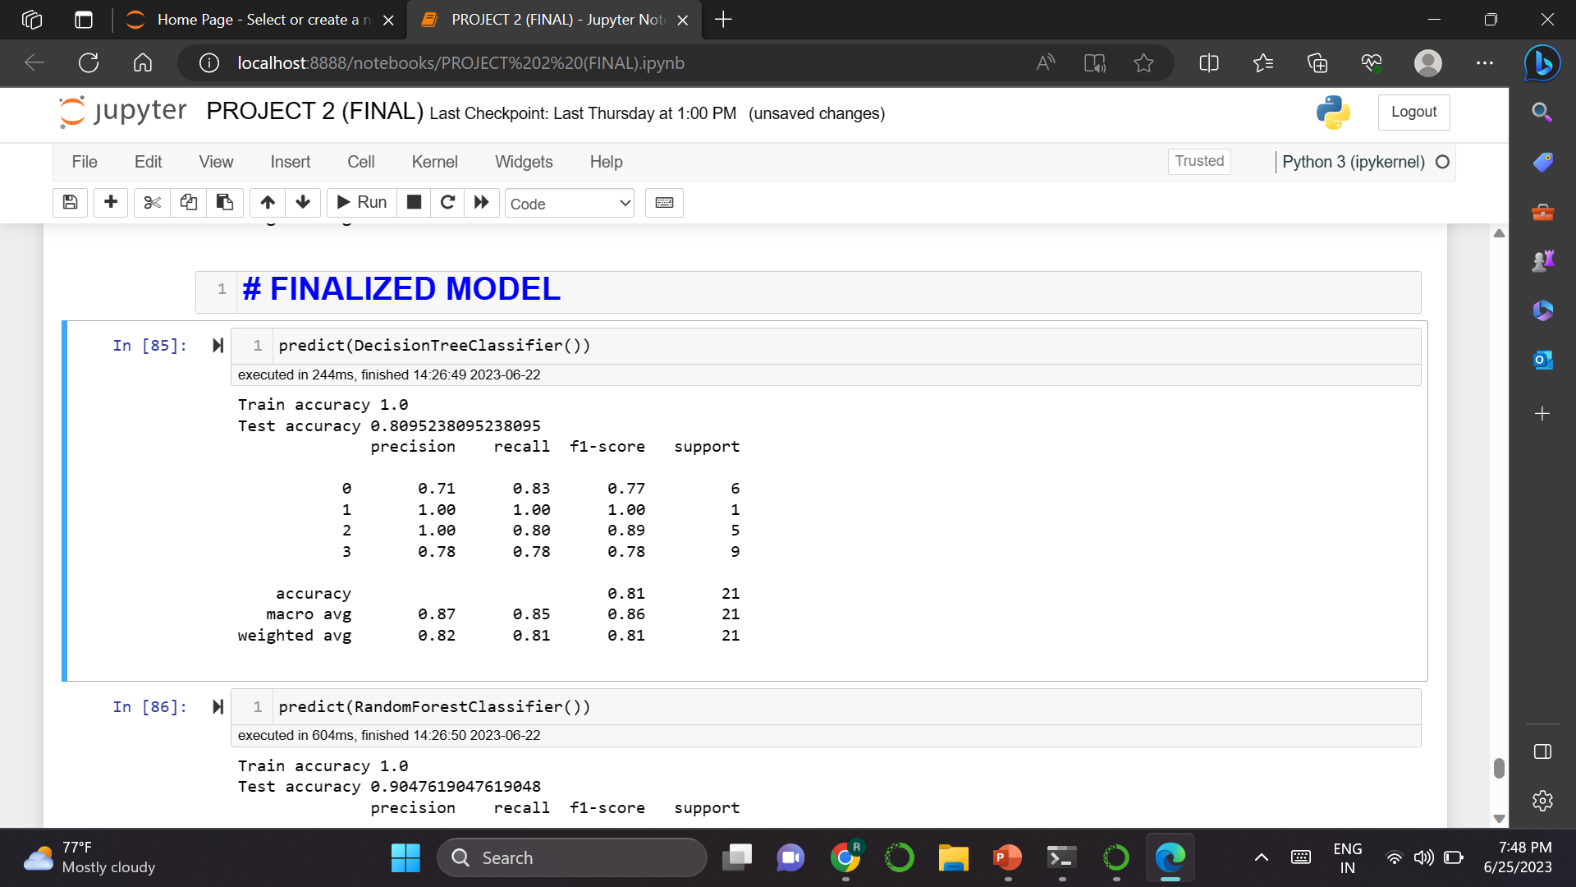

Slide 9
Challenges faced for this project
Had to install many libraries which were required like textract, docx, python-docx, antiword, pdftotext, PyPDF2.
While Extracting the data from the zipped file got many errors there were different formats to all the files.
After extraction data cleaning took a lot of time , and feature selection was also little complicated.
Output of the models were changing everytime we re-run it.
Faced many issues & errors while writing the codes for Deployment.

